Slide 1
EMPATHY MAPS

Slide 2

💬Say “I wish the wedding wasn’t so expensive I really wanted to travel this year” “We really should start looking at the idea of buying our own place” “I hope I get that raise soon” “My car is gonna need some new parts” | ✋Do Works full time as a Plane Systems Engineer Shares expenses with her partner Has started saving again after the expenses they had with the wedding Budgets her finances using an Excel Sheet Has started making her own clothes and thrifting
💭Think For now we are ok financially but if we want to have kids we need to start saving as much as we can. Maybe we can save by cutting back on some unnecessary expenses like date nights and snacks. Maybe I shouldn’t stress so much about this we just got married, we have time to think about a house and a kid. | 💜Feel Radiant with her marriage and with the new life they are building together A bit stressed because they currently have no savings Excited with the prospects of the future and the idea of starting her own family

Slide 3
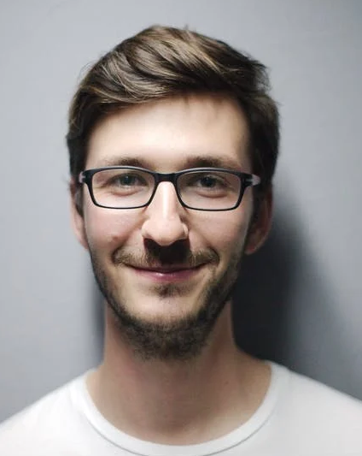
💬Say “One day I will own my own Inn” “I know mom it’s time for me to move out but this way I can save a lot more to put into my dream” “I have done a lot of research on this and I think with the government youth programs I can remodel great-grandma’s old farm into a nice inn” | ✋Do Works full time as a Hostel Receptionist Has saved substantially in the last years in order to invest in his dream Has started to put together a proposal for a loan talked with several accountants Has started to look for rooms to rent in order to move out of his parents place
💭Think Am I really capable going into business by myself and taking on such a large project? Am I making a mistake? This could go horribly wrong and I will be left in debt. I haven’t even left my parents house how am I responsible enough for this? What will I do if don’t get the money to back this up? | 💜Feel Hopeful but also scared about the future Scared with starting such a big endeavour so young especially with the prospect of taking a loan Nervous about leaving home and living alone Overwhelmed with all the work he has to do by himself in order to start his own business

Slide 4

💬Say “I’m have no idea how I’m gonna pay my student loans in time” “You have to understand we can’t keep going out like we used to, we have to save if we want to get a place of our own” “I just spent all this money in a degree and now I can’t even find a job doing what I love” | ✋Do Works part-time at a gym (24 hours a week) Is looking for a full time job in Graphic Design Has cut back in all of her hobbies that require spending money Started to pay off her student loans Started saving to move into her own place
💭Think What do I do if I can’t find a better job? There’s no way I will be able to save enough to have my debt clear by the time I am 30 My parents can’t keep sending me money like this, I am an adult now Maybe I should have gone into engineering like everyone told me | 💜Feel Stress about the lack of money and the --—-------- amount of student loans she still has to pay Annoyed for having to share her house with so many people and not having her own space Scared about the future and her job prospects Guilt by the fact her parents still send her money

